Slide 1
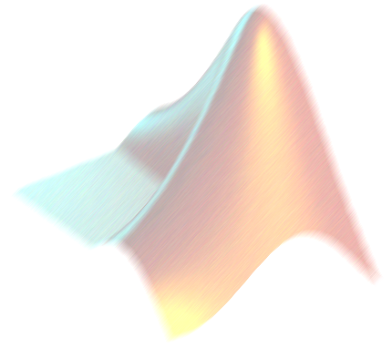
NUMERICAL DIFFERENTIATION AND INTEGRATION
AM2032 JAYANTA MUKHERJEE

Slide 2
Numerical Differentiation
Methods of finding a derivative
Analytic methods
  requires hard work
  produces exact answer
  not always possible
Symbolic methods
  computer does hard work
  produces exact answer
  not always possible
Numerical methods
  computer does the hard work
  produces approximate answer
  always possible

Slide 3


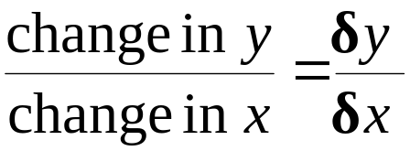
Gradient
Y
X
Gradient =

Slide 4
Gradient at a Point
Y
y = f(x)
Tangent at x=a
(a, f(a))
x
X
f ′(a) = the gradient (slope) at the point x.

Slide 5
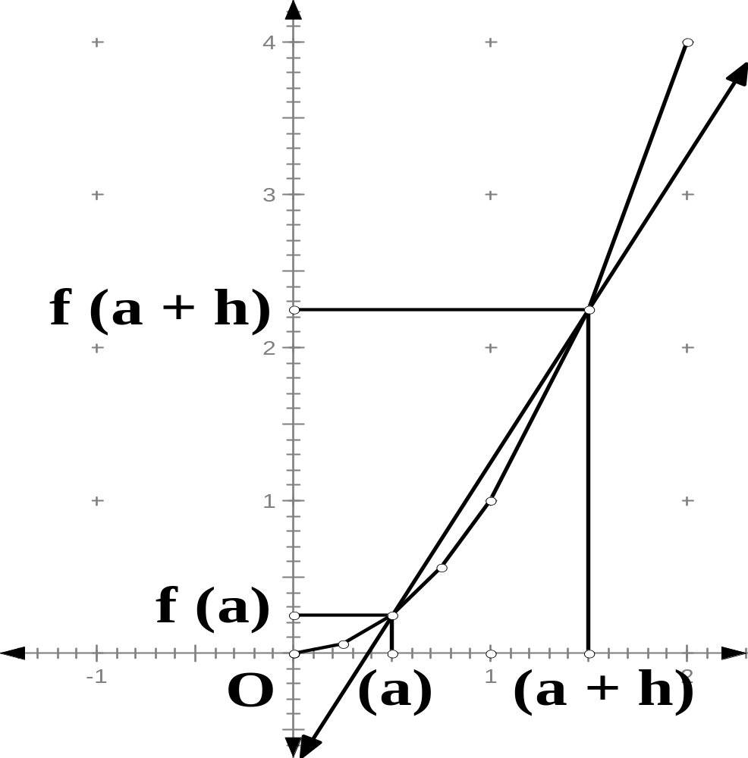
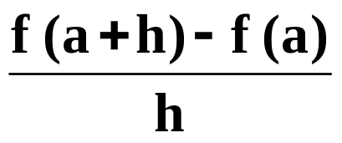
Gradient at a Point-cont.
Q
slope
f (a + h) – f (a)
h
Average rate of change
P

Slide 6
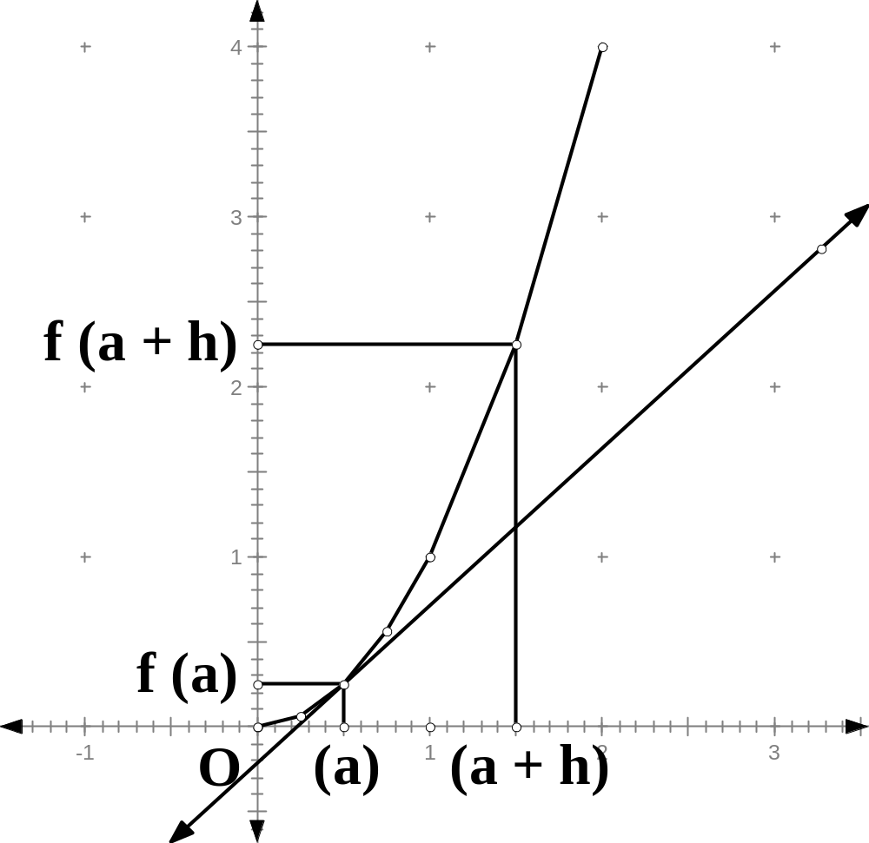
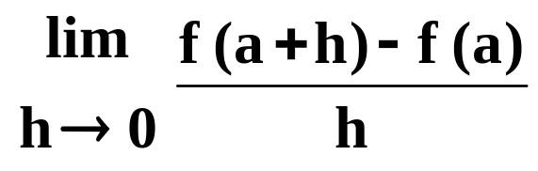
Instantaneous Rate of Change
Q
Tangent
Slope of tangent.
Instantaneous Rate of Change.
f (a + h) – f (a)
P
h
Let h approach 0

Slide 7
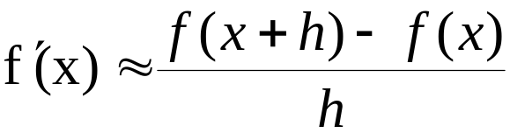
Forward Approximation
Y
y = f(x)
(x + h, f(x+h))
(x, f(x))
x
x + h
X
Approximate f ′(x) by using forward differences
Use chord joining x to (x + h, f(x+h)) , h should be very small

Slide 8
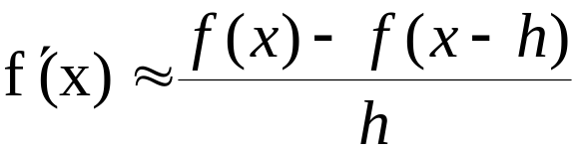
Backward Approximation
Y
y = f(x)
(x, f(x))
(x - h, f(x- h))
x - h
x
X
Approximate f ′(x) by using backward differences
Use chord joining (x - h, f(x-h)) to x , h should be very small

Slide 9
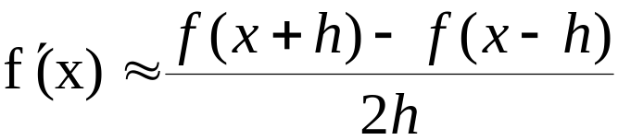
Central Approximation
Y
y = f(x)
(x + h, f(x+h))
(x, f(x))
(x - h, f(x- h))
x - h
x
x + h
X
Approximate f ′(x) by using central differences
Use chord joining (x - h, f(x-h)) to (x + h, f(x+h)) ,h should be very small

Slide 10
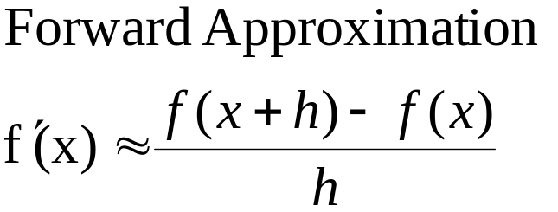
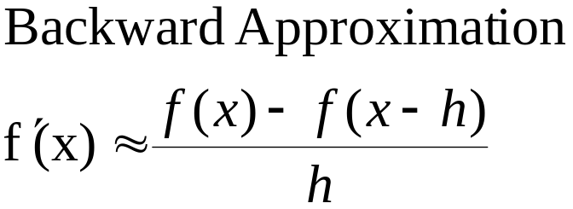
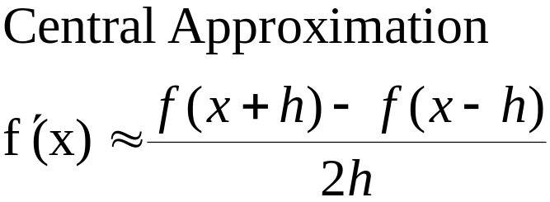
Summary
Y
y = f(x)
x - h
x
x + h
X

Slide 11
Taylor Series
Which Approximation is Best to Use?
Taylor series expansion of a function f(x) at point x close to point a

Slide 12
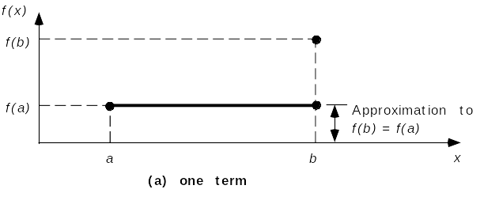
Taylor Series
Find f(b) given f(a)
Using just one term

Slide 13
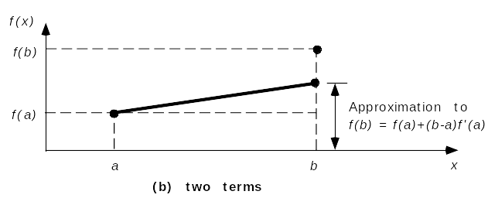
Taylor Series
Find f(b)
Using two terms

Slide 14
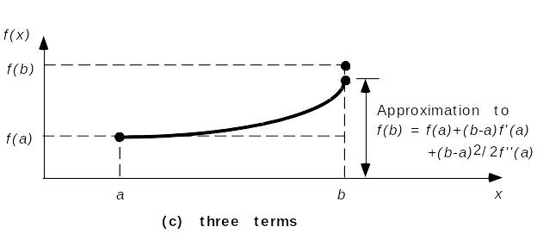
Taylor Series
Find f(b)
Using three terms

Slide 15
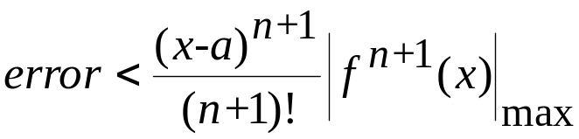

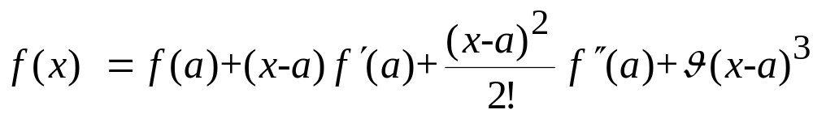
Error in Truncating Taylor Series
If we truncate the series after the nth term, the error will be
For example, if we truncate after the 3rd term

Slide 16
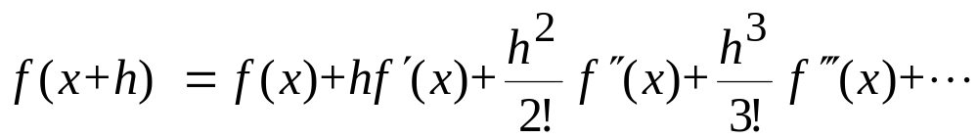

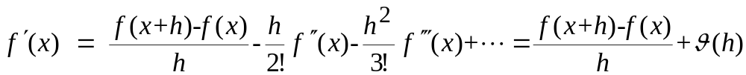
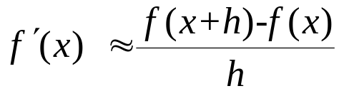
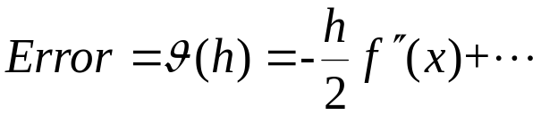
Forward First Derivative
Consider the Taylor series expansion of f(x) near a point ‘x’
Solve for
Truncate here
First order approximation of first derivative

Slide 17
Backward & Central First Derivative
Instead of f(x+h), now expand f(x-h) to get the backward difference formula
Subtract f(x-h) expansion from f(x+h) expansion to get the central difference formula
Y
y = f(x)
The central approximation should always be best….
Why?
Error of the order of h²
x - h
x
x + h

Slide 18
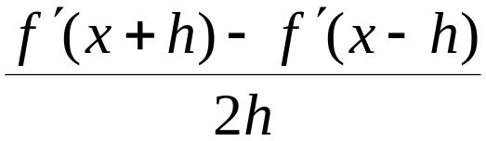

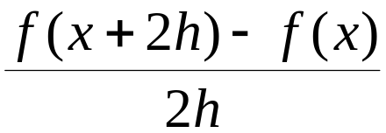
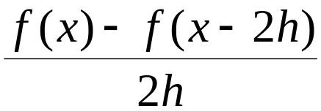


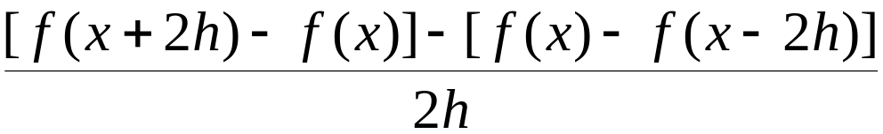

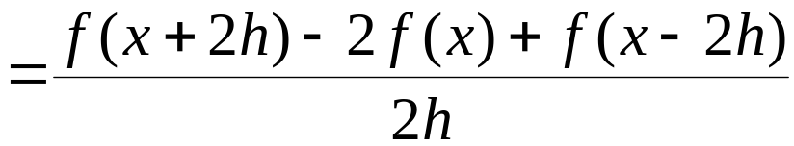
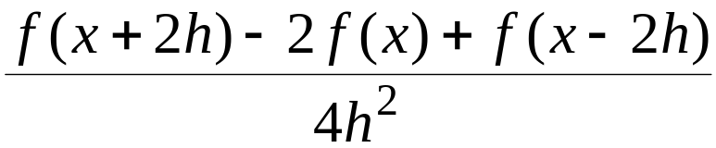
The Second Derivative

Slide 19
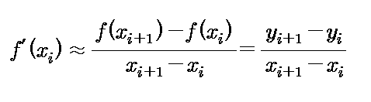
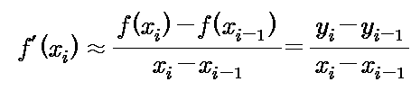

Another Way of Writing these Formulae (the first derivatives)
Forward difference formula
Backward difference formula
Central difference formula

Slide 20
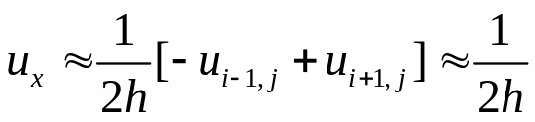
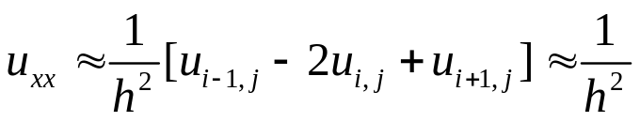
The Partial Derivatives
Partial derivative of a function of two variables
  General point as (x_{i}, y_{j} )
  The value of the function u(x, y) at that point as u_{i, j}
  The spacing in the x and y directions is the same, h
  Using subscripts to indicate partial differentiation
-1
0
1
j
i-1
i
i+1
1
-2
1
j
i-1
i
i+1

Slide 21


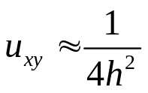
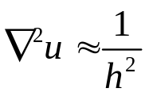
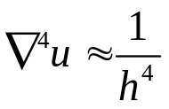
The Partial Derivatives
For the mixed second partial derivative and higher derivatives, the schematic form is especially convenient.
The Laplacian operator
The bi-harmonic operator
-1
0
1
j+1
1
j+1
0
0
0
j
1
-4
1
j
1
0
-1
j-1
1
j-1
i-1
i
i+1
i-1
i
i+1
1
2
-8
2
1
-8
20
-8
1
2
-8
2
1

Slide 22
Numerical Integration
Finding Areas Numerically

Slide 23
Finding Areas Numerically
The basic idea is to divide the x-axis into equally spaced divisions as shown and to complete the top of these strips of area in some way so that we can calculate the area by adding up these strips.
y₁
y₂
y₃
y₄
y₅
h
h
h
h
a
b

Slide 24





Finding Areas Numerically
The first way is to complete the strips as shown. We are then adding up rectangles of height and width .
In this case the area is →
Note that the last y-value is not used.
y₁
y₂
y₃
y₄
y₅
a
b
h
h
h
h

Slide 25
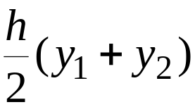
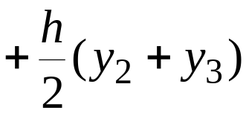
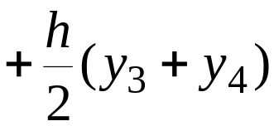
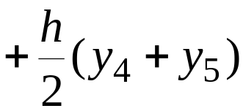
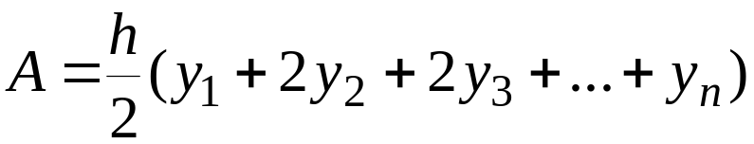
Finding Areas Numerically
The Trapezium (Trapezoidal) rule:
Complete the strips to get trapezia. Add up areas of the form
y₁
y₂
y₃
y₄
y₅
a
h
h
h
h
b

Slide 26
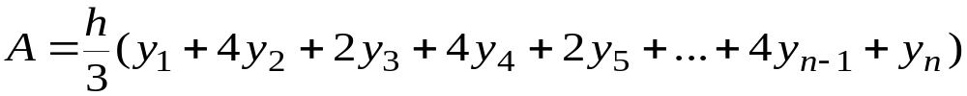
Finding Areas Numerically
Simpson’s Rule:
We complete the tops of the strips as shown with parabolas.
y₁
y₂
y₃
y₄
y₅
a
b

Slide 27
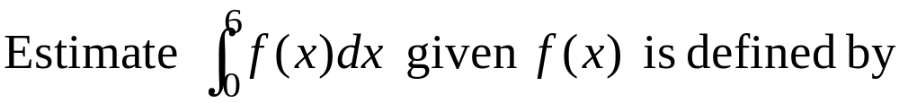



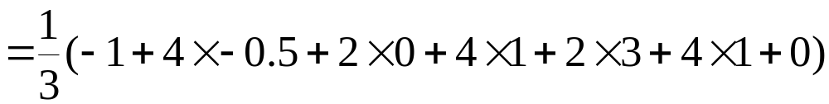

Examples
x
x
0
1
2
3
4
5
6
y
-1
-0.5
0
1
3
1
0
Rectangle
Trapezium
Simpson

Slide 28
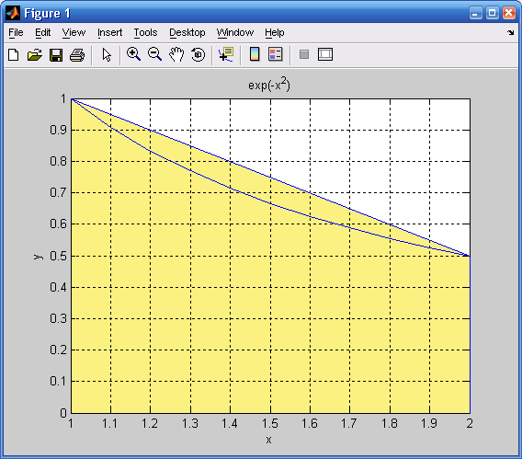
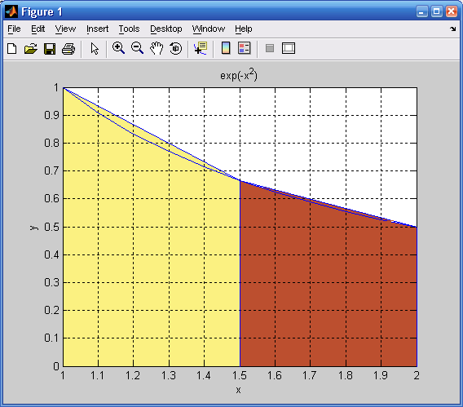
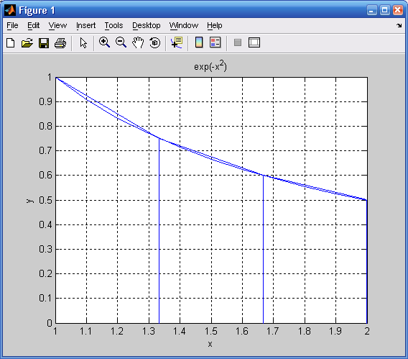
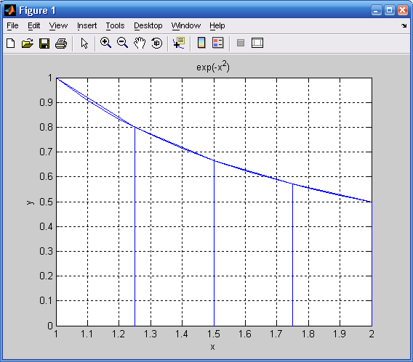
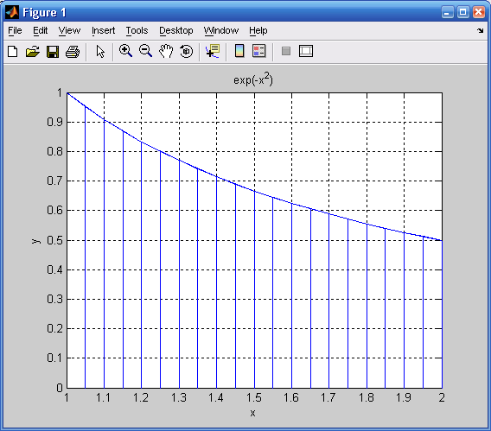
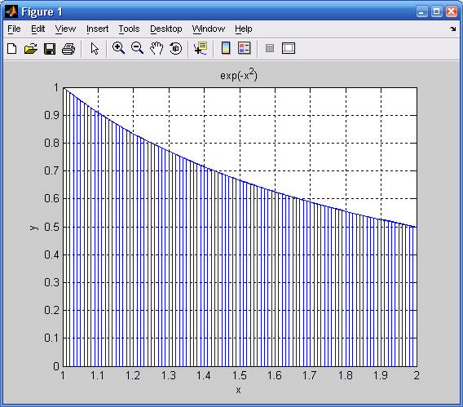
Choosing the Step Size ‘h’
h=(a-b)/n
Choose large ‘n’ to reduce errors
Trapezoidal Rule
Similarly for Simpson's Rule
n=1 n=2 n=3
n=4 n=20 n=100

Slide 29
Merits and Demerits
Trapezoidal rule
  advantages
    there can be any number of data points
    the data points can be arbitrarily spaced
  disadvantages
    the error only reduces proportionally to the data spacing
Simpson’s rule
  advantages
    the error reduces proportionally to the square of the data spacing
  disadvantages
    there must be an odd number of data points
    the data points must be evenly spaced

Slide 30
In the next lecture we will look in more detail on these and some more methods of numerical integration

